Slide 1
Project: Sberbank Russian housing market Price Prediction
PRESENTED BY- SAKSHI KARNAWAT

Slide 2
Overview
Proposal:
https://www.kaggle.com/c/sberbank-russian-housing-market/overview
Description : This is an extremely rich data set with broad spectrum of features

Slide 3
Problem Statement
The company has tasked us with developing algorithms which use a broad spectrum of features to predict realty prices. We can rely on only a rich dataset that includes housing data and macroeconomic patterns. An accurate forecasting model will allow your company to provide more certainty to their customers in an uncertain economy.

Slide 4
Tasks Performed:
Technique Used: Regression
Data analysis
Data cleaning
Outlier Analysis
Feature Engineering
Model Creation
Model Evaluation
Hyperparameter Tuning

Slide 5
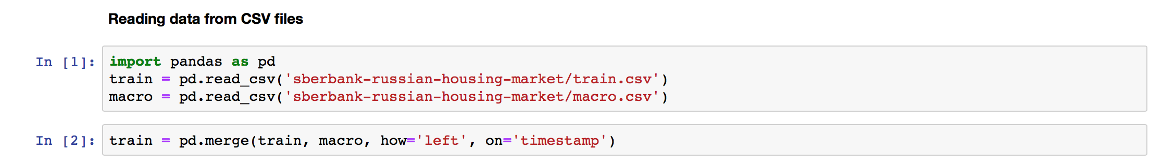
Reading the Data
There were two types of file:
train.csv: Input collection of features about each property's surrounding neighbourhood, and some features that are constant across each sub area (known as a Raion).
Macro.csv: Input set of macroeconomic indicators, one for each date.
After doing a simple pd.read command from pandas to read the .csv files, I have merged these two files into a single file on ‘timestamp’ as follows:

Slide 6
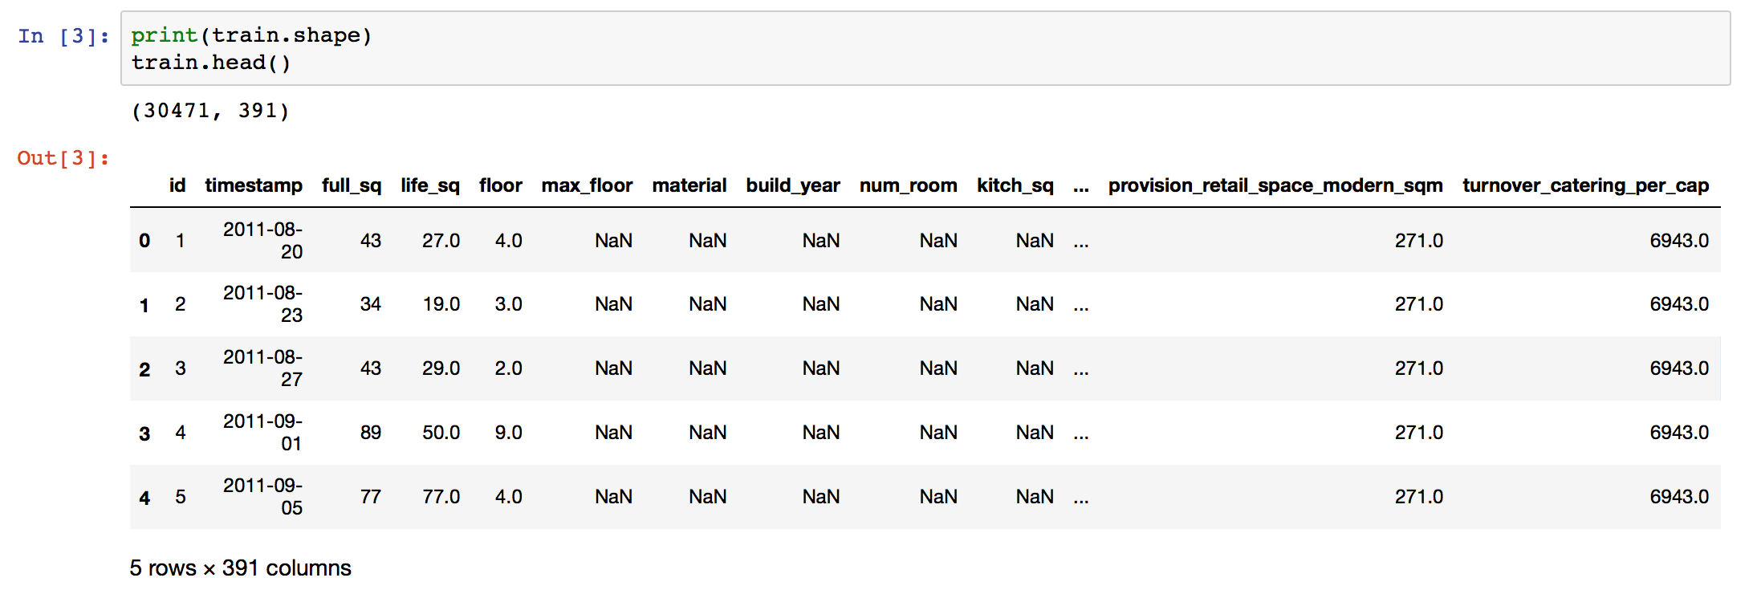
What was data was provided?
The data consisted of 391 columns of features and 30,471 rows !!!
There were 4 different Data Types namely:
Integer
Float
Object
Date

Slide 7
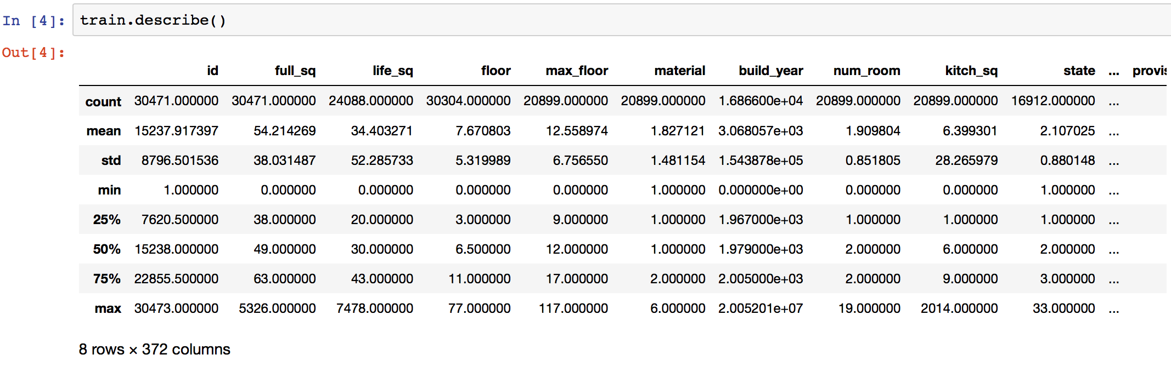
What data was provided?
Here we can see that the number of columns reduced, this happened because describe was only for numerical continuous data and doesn't include the non-numerical data.

Slide 8
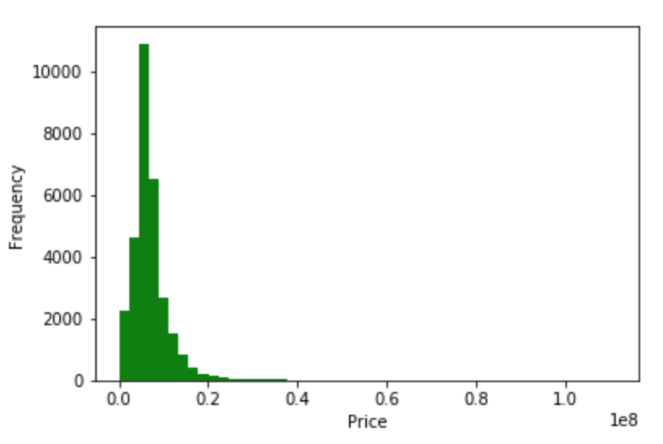
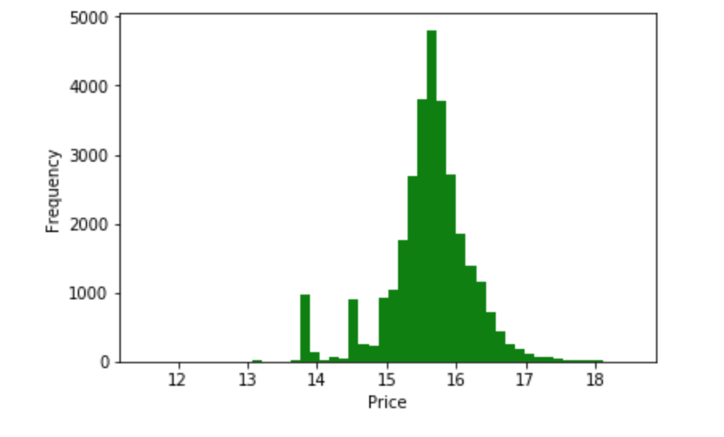
Data Analysis:
Analysing the target variable: Price
In pricing dataset we can see that there is a lot of skewness in the target variable and taking logarithm can give a good normal distribution

Slide 9
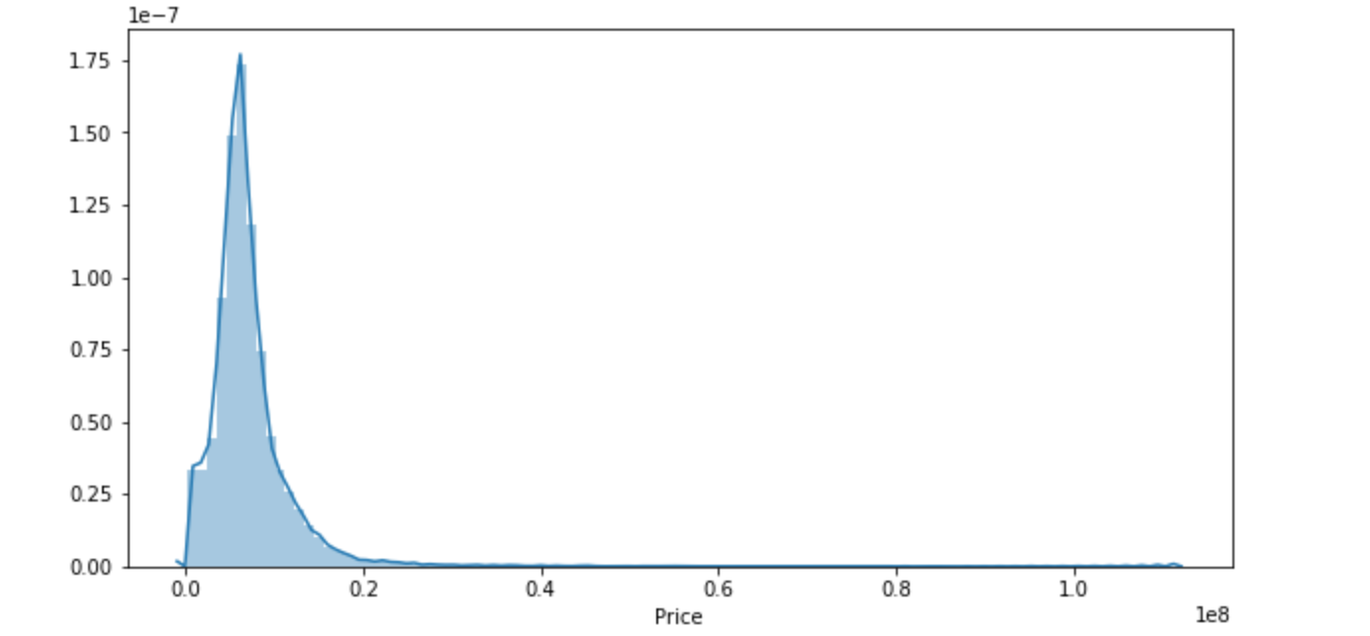
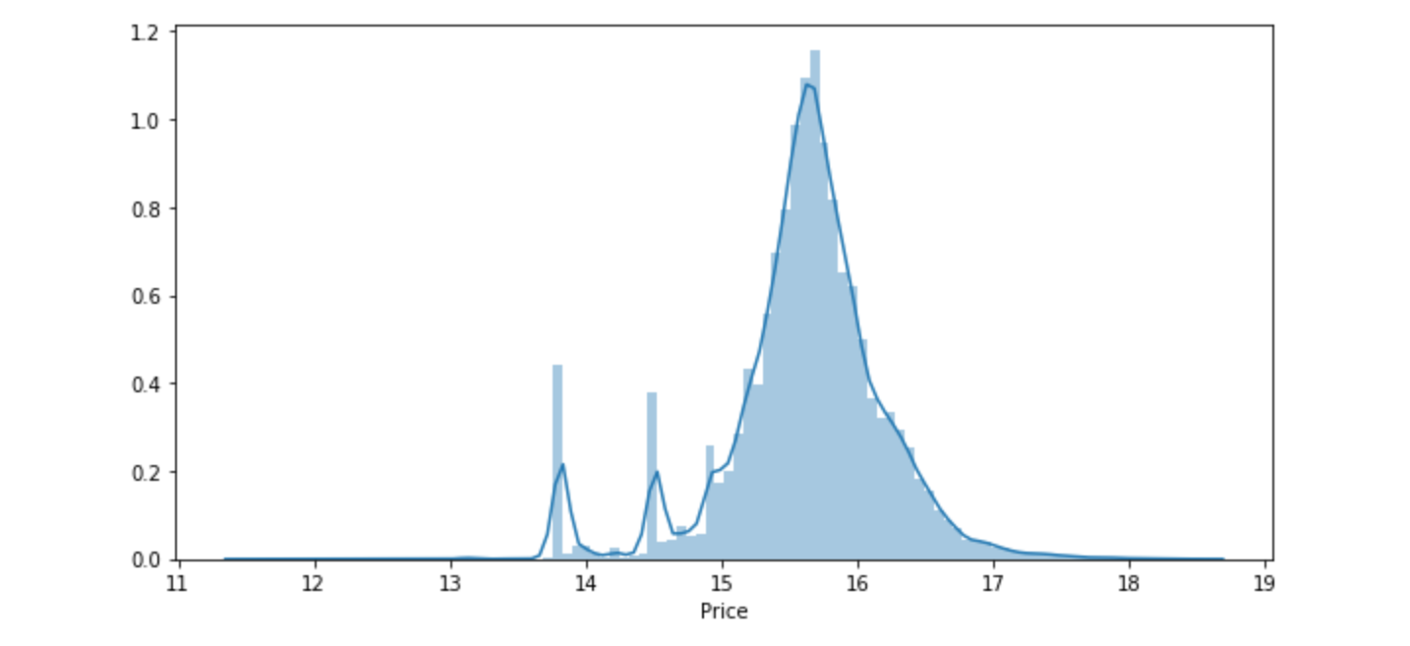
Data Analysis:
Analysing the target variable: Price
Similarly here we can see there is a lot of skewness in the dataset.

Slide 10
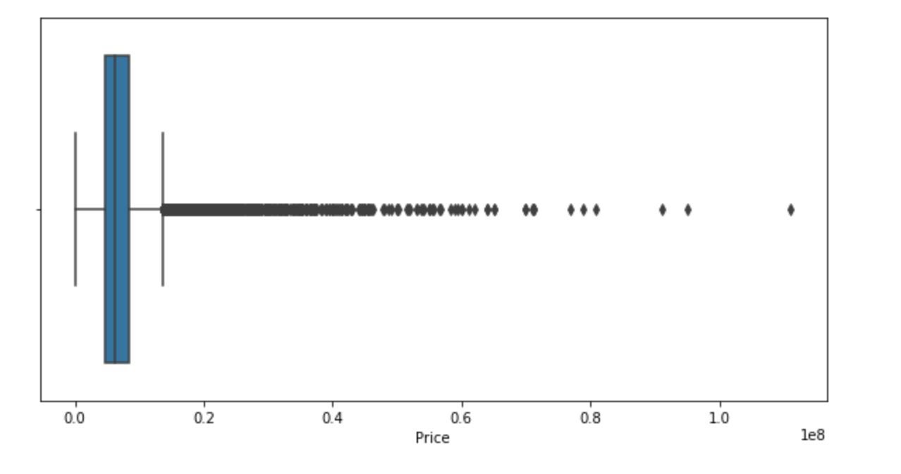
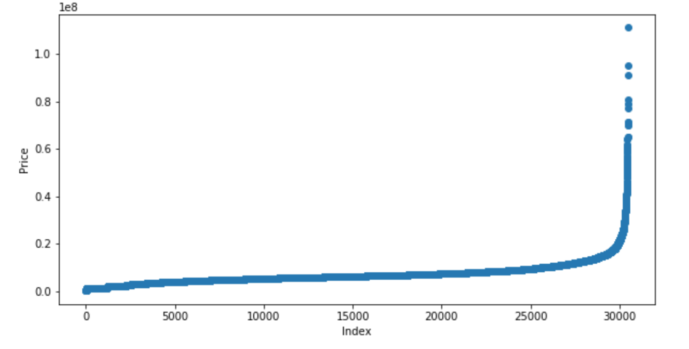
Outlier analysis for target variable
We can clearly see that there are some noticeable outliers in the target variable.

Slide 11
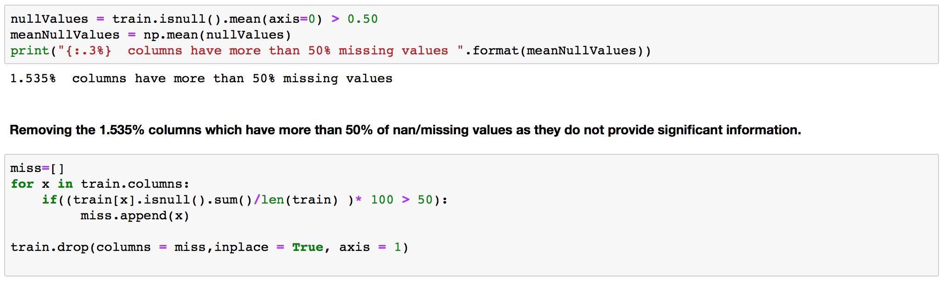
Data Cleaning: Handling Missing Values
There were a lot of missing values in the dataset. I checked it using a simple command:
Next i checked if there were any columns with more than 50% of data missing and removed them as they were uninformative
This reduced a total of 6 columns!!

Slide 12
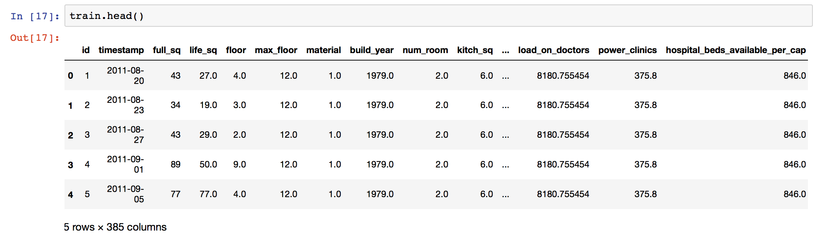
Data Cleaning: Handling Missing Values
Missing Values
Next we impute the missing values first by using median.
No more missing values!

Slide 13
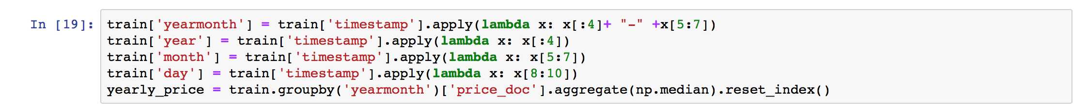
Feature Extraction: Extracting useful information from timestamp
We extract year-month from the timestamp
We also extract year, month, and day from the timestamp to gather useful information

Slide 14
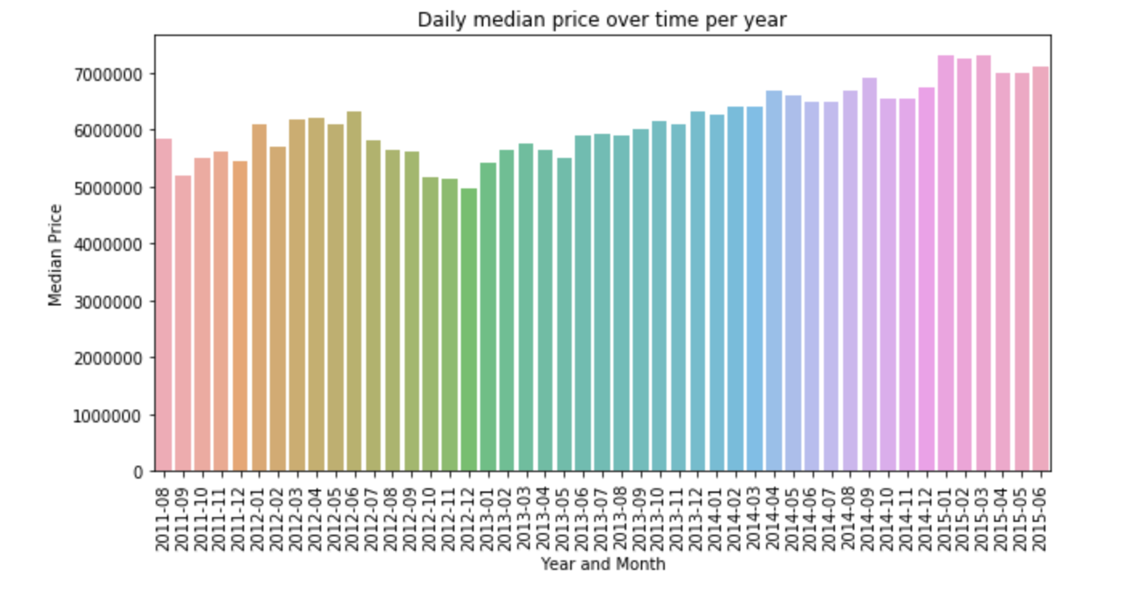
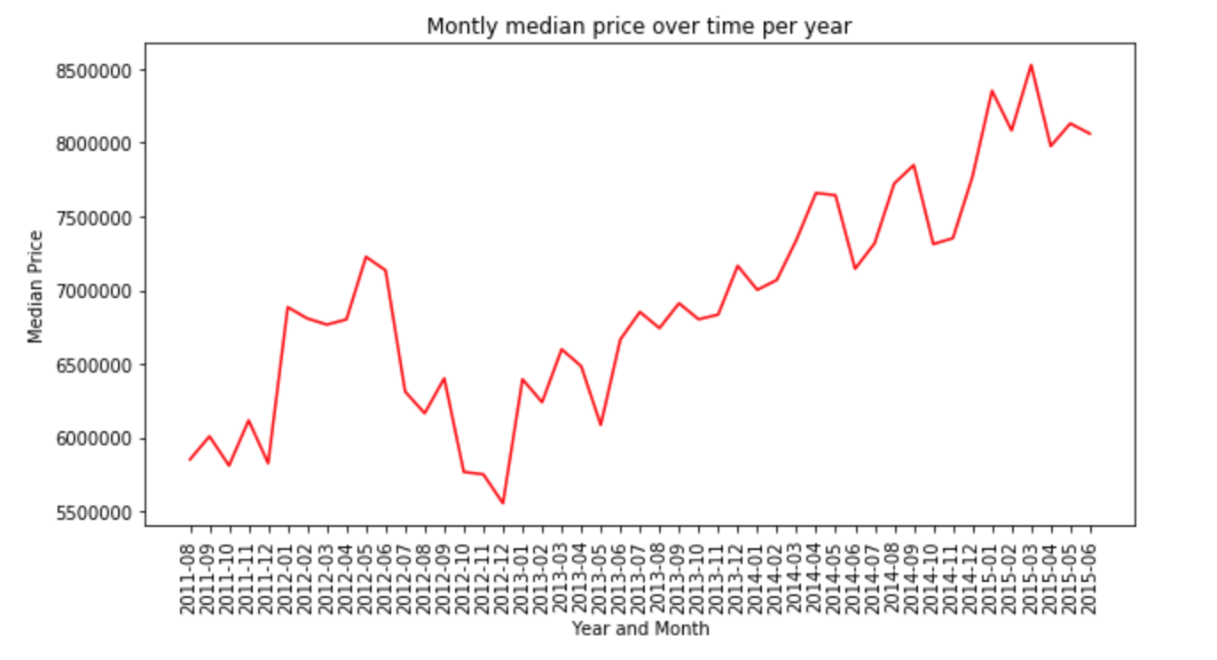
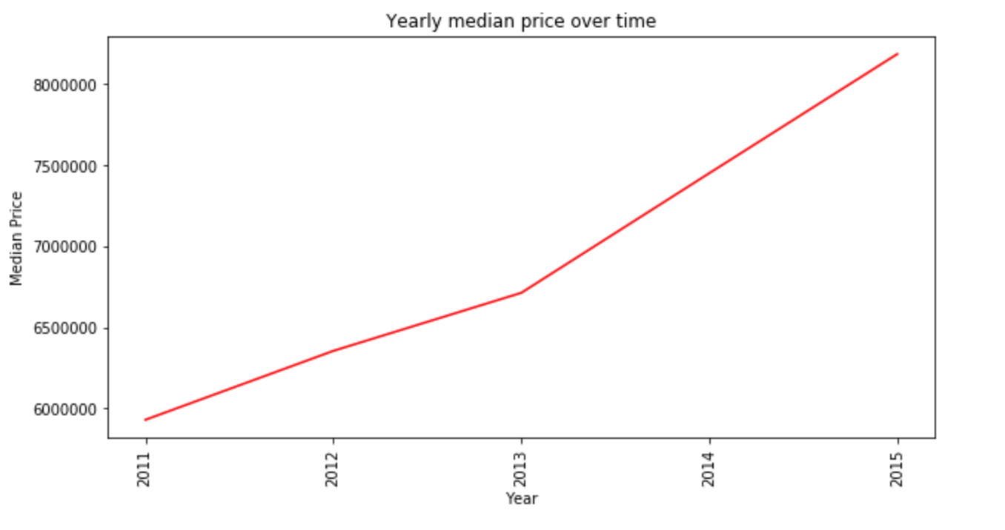
Feature Extraction: Extracting useful information from timestamp
From February 2013 the price has been linearly increasing

Slide 15
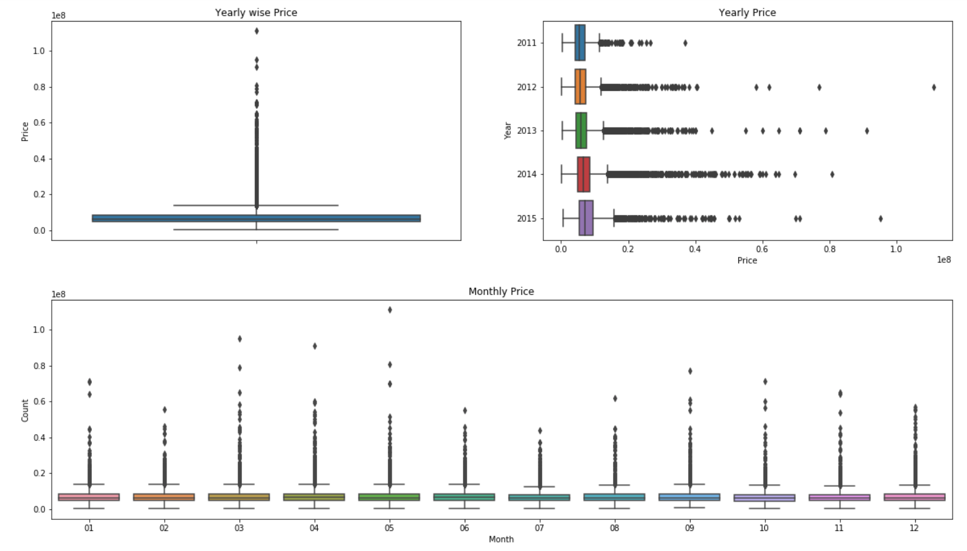
Outlier Analysis with respect to timestamp
There are three types comparisons:
Year wise price, Yearly Price and finally monthly price.

Slide 16
Some important variables to look at:
Some important variables of the dataset and their description from the data dictionary are listed below:
floor - for apartments, floor of the building
max_floor - number of floors in the building
build_year - year built
full_sq - total area in square meters, including loggias, balconies and other non-residential areas
life_sq - living area in square meters, excluding loggias, balconies and other non-residential areas
state - apartment condition
kitch_sq: kitchen area

Slide 17
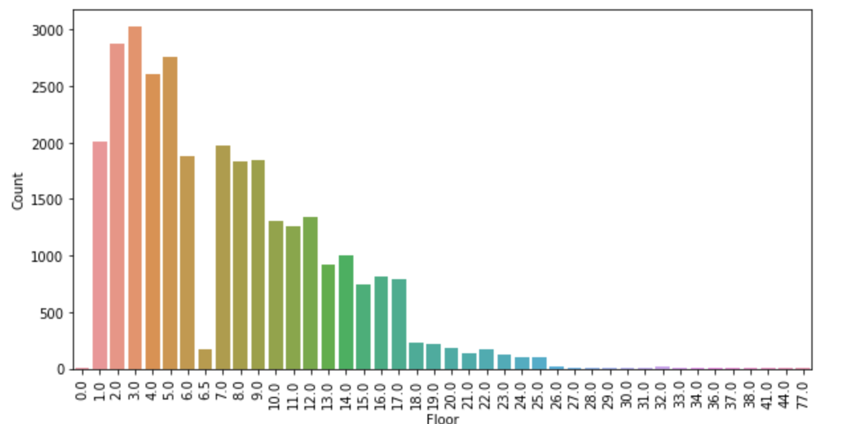
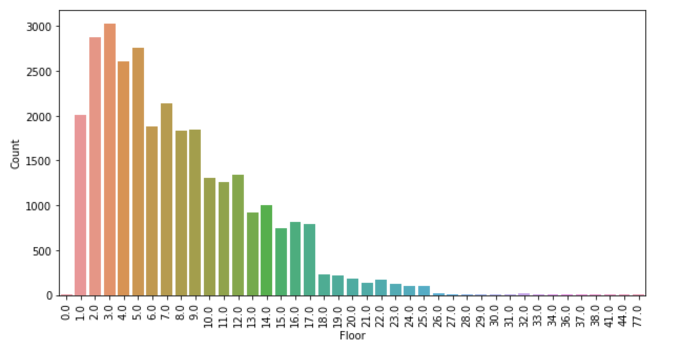
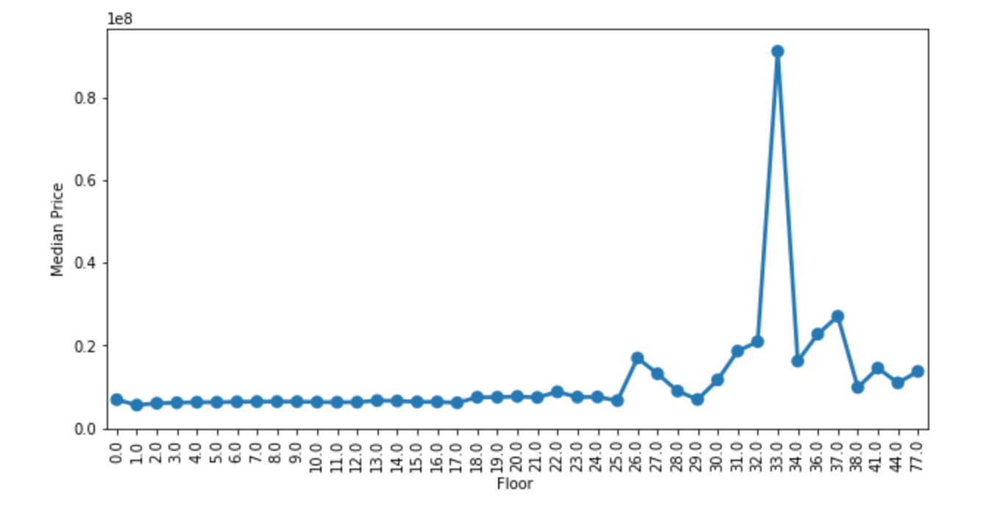
Floor
Observations: The price seems to be constant until floor 18, after floor 18 there has been a significant increase in price and it seems that floors 33 has the highest price

Slide 18
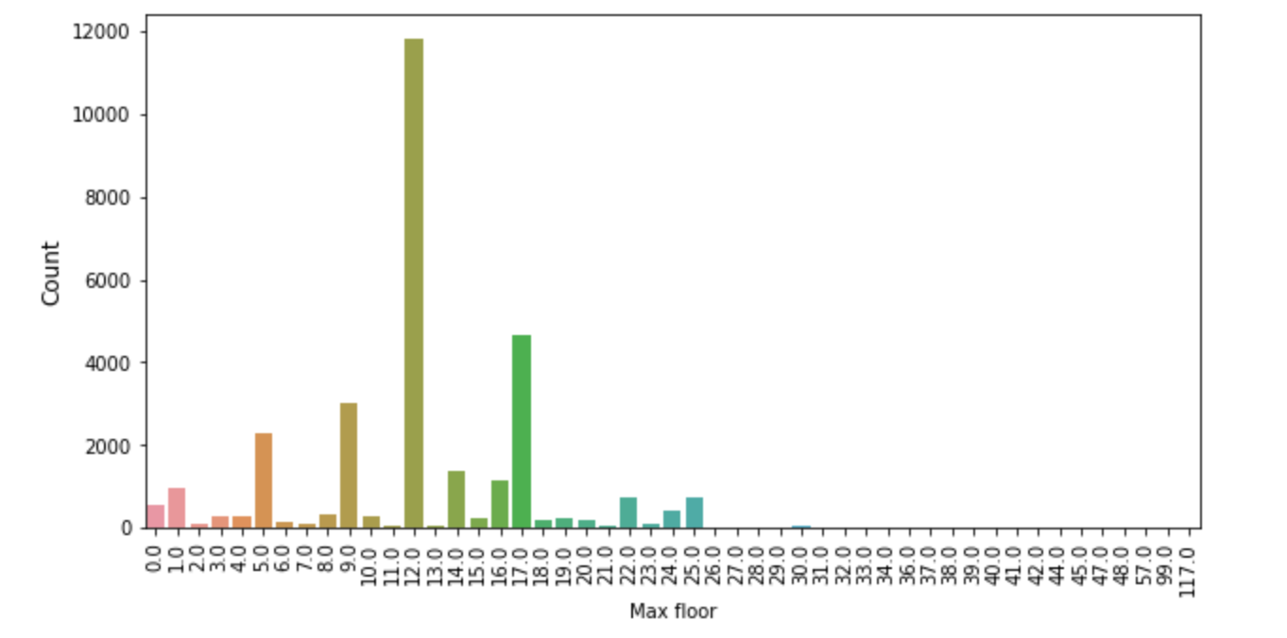
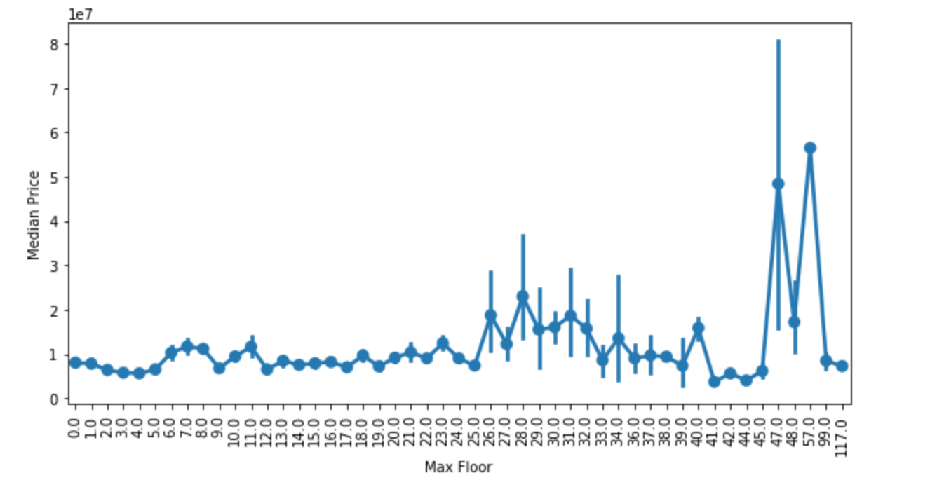
MAX Floor
Observations: The price varying a lot but it is significantly high when the max floors of the building are from 47 floors to 57 floors.

Slide 19
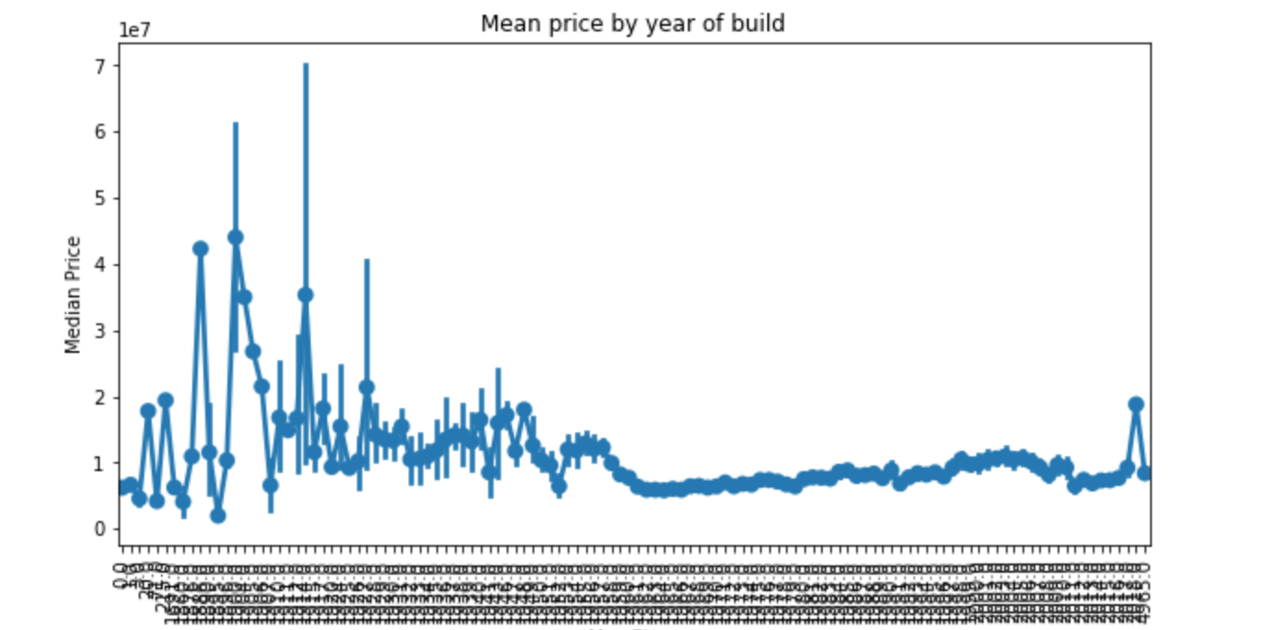
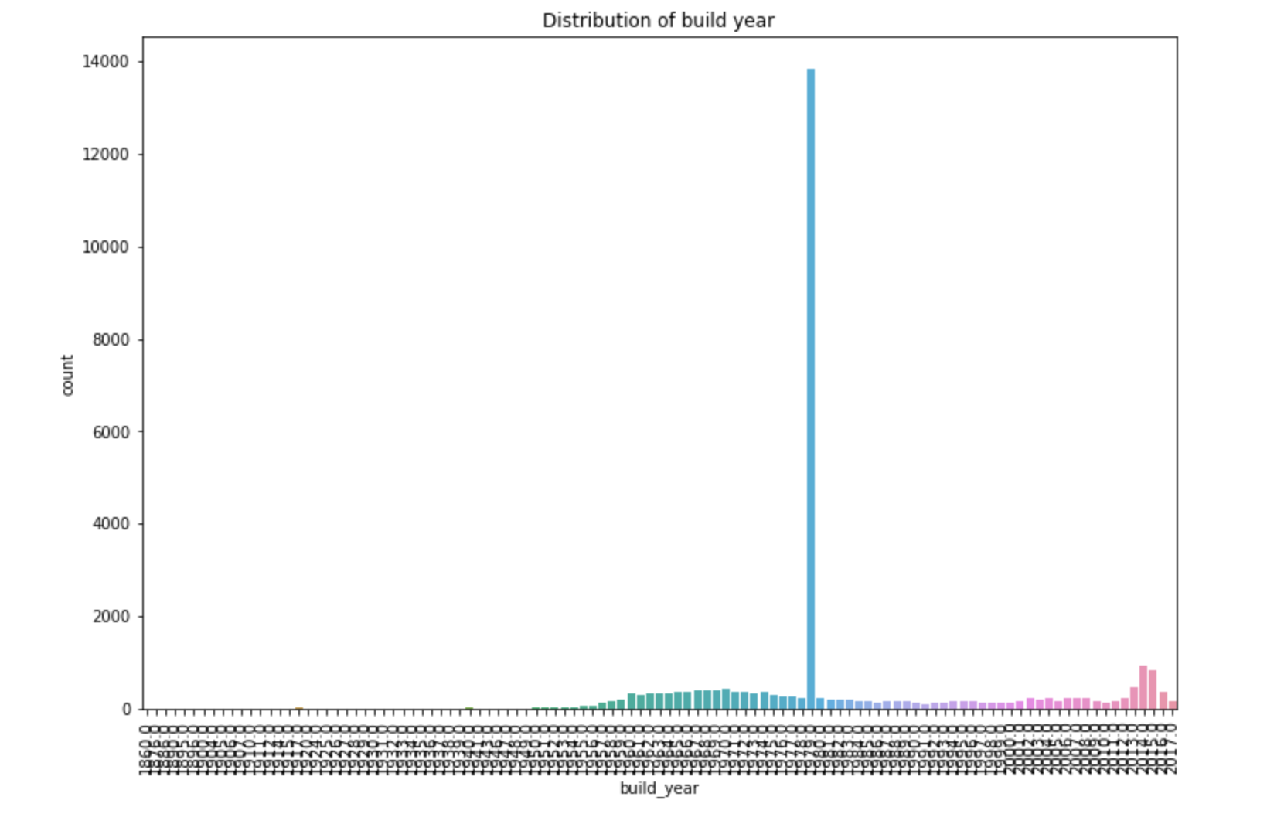
Build Year

Slide 20
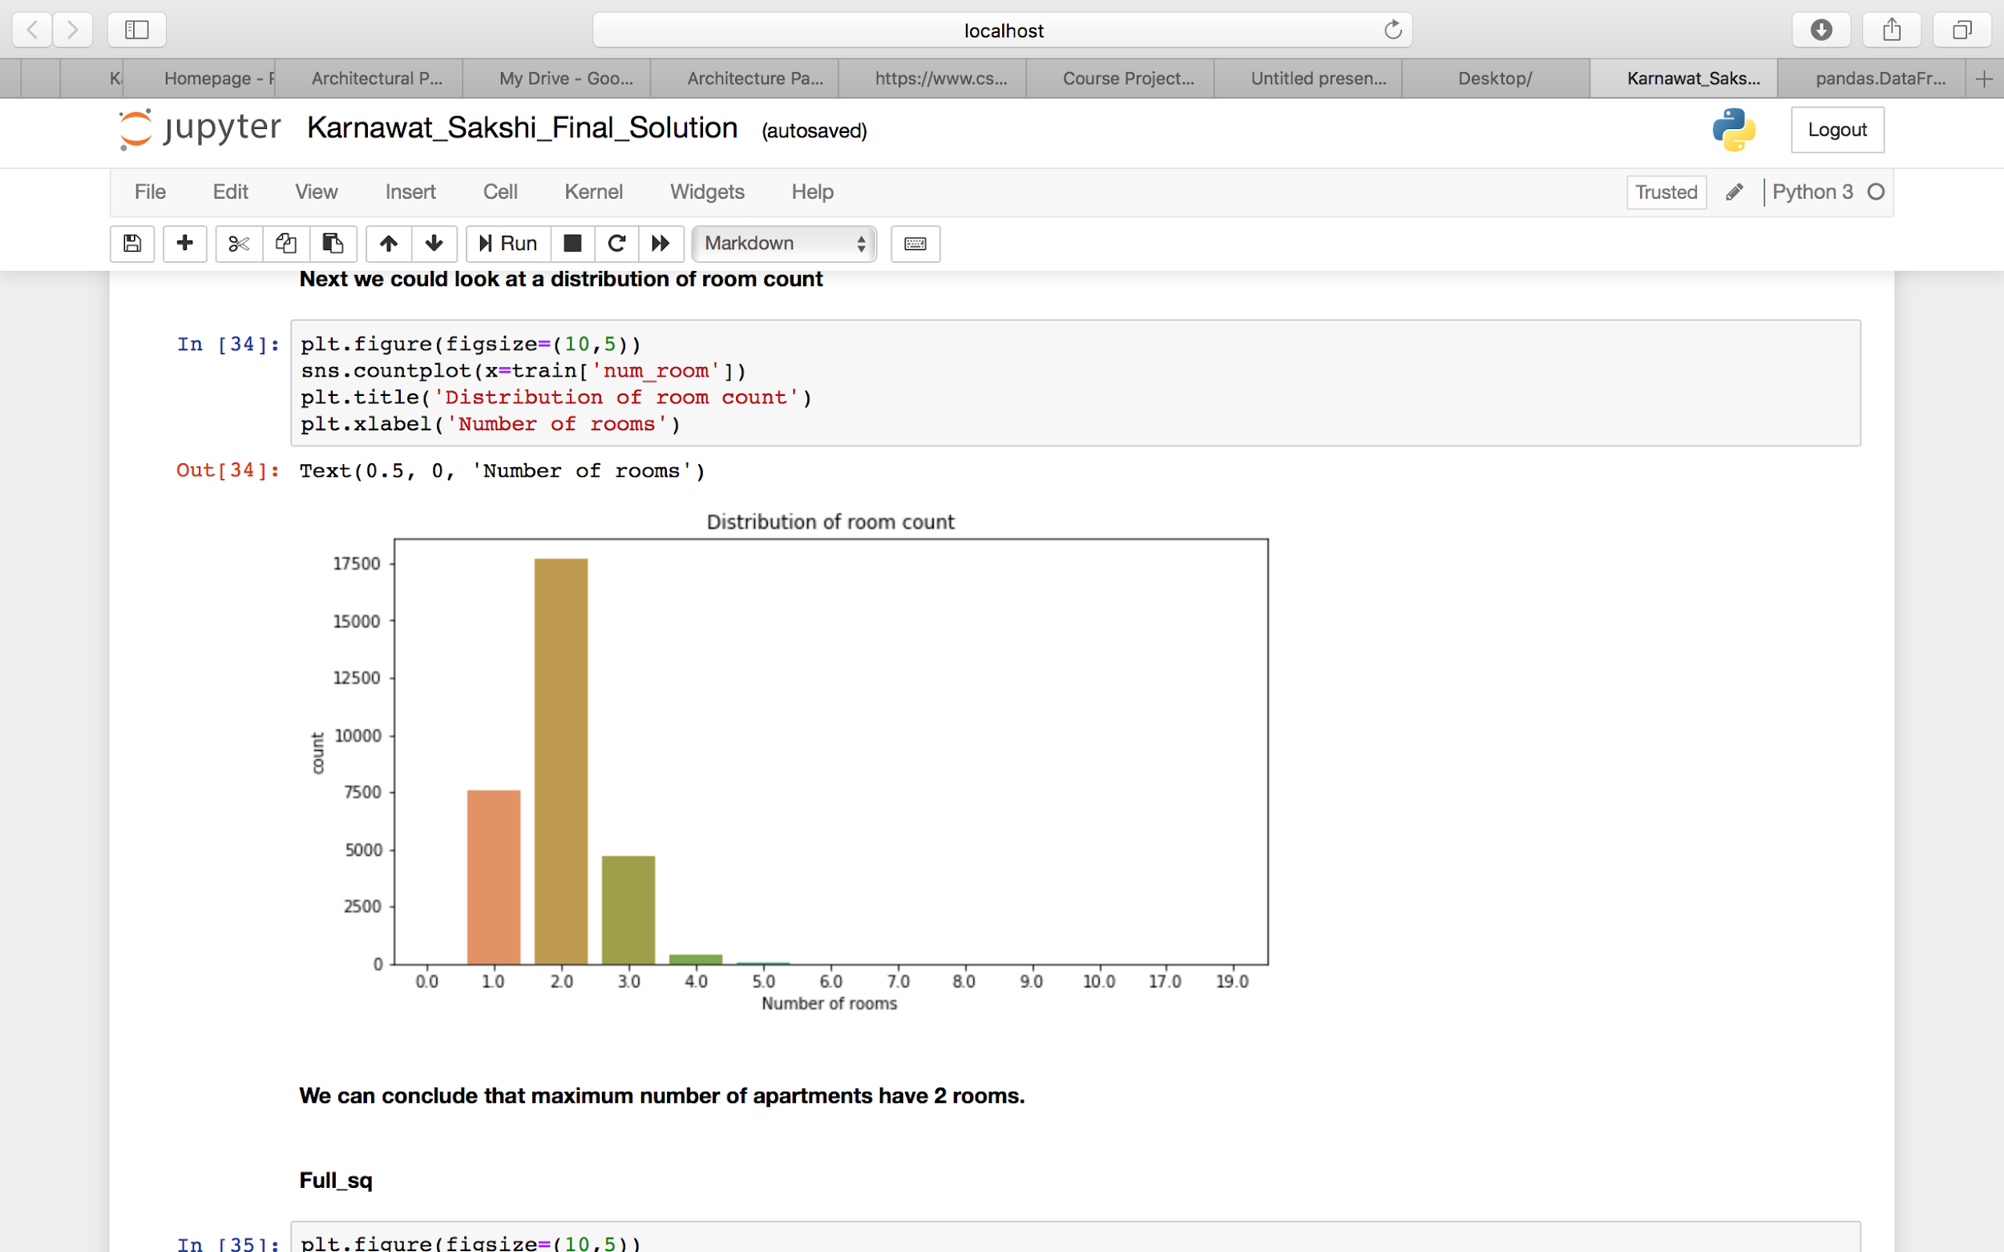
Room Count
Observation: Maximum number of apartments have 2 rooms.

Slide 21
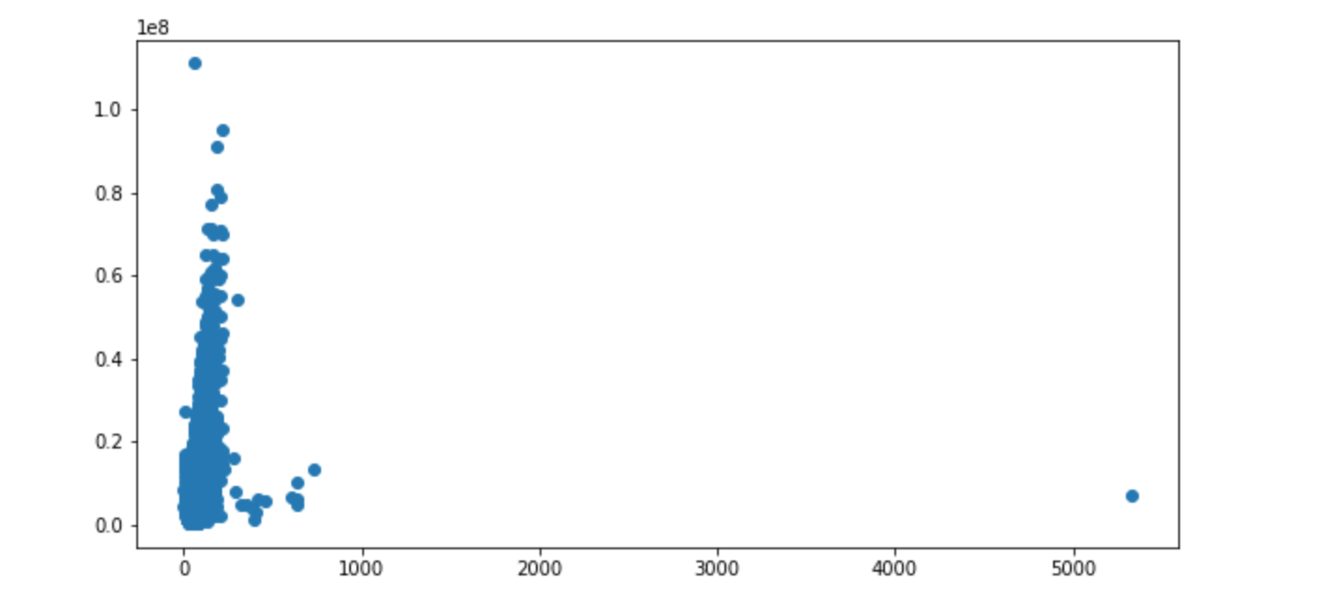
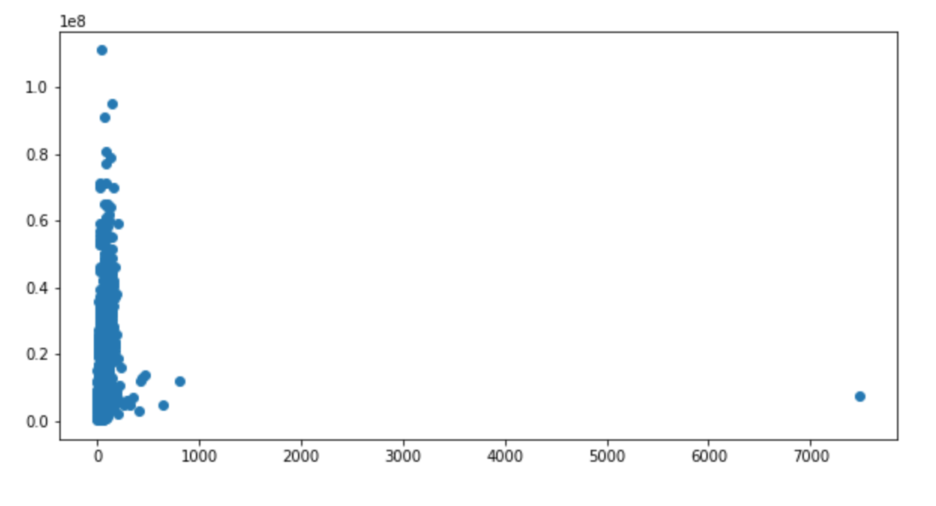
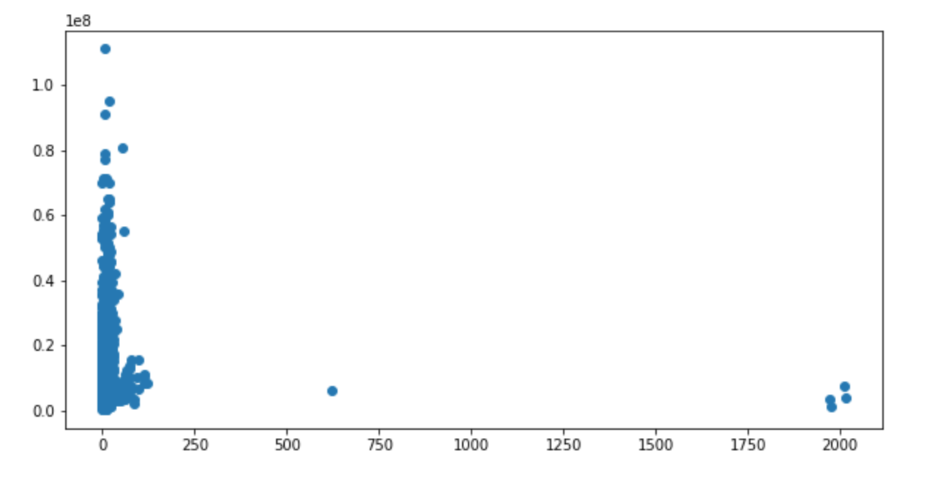
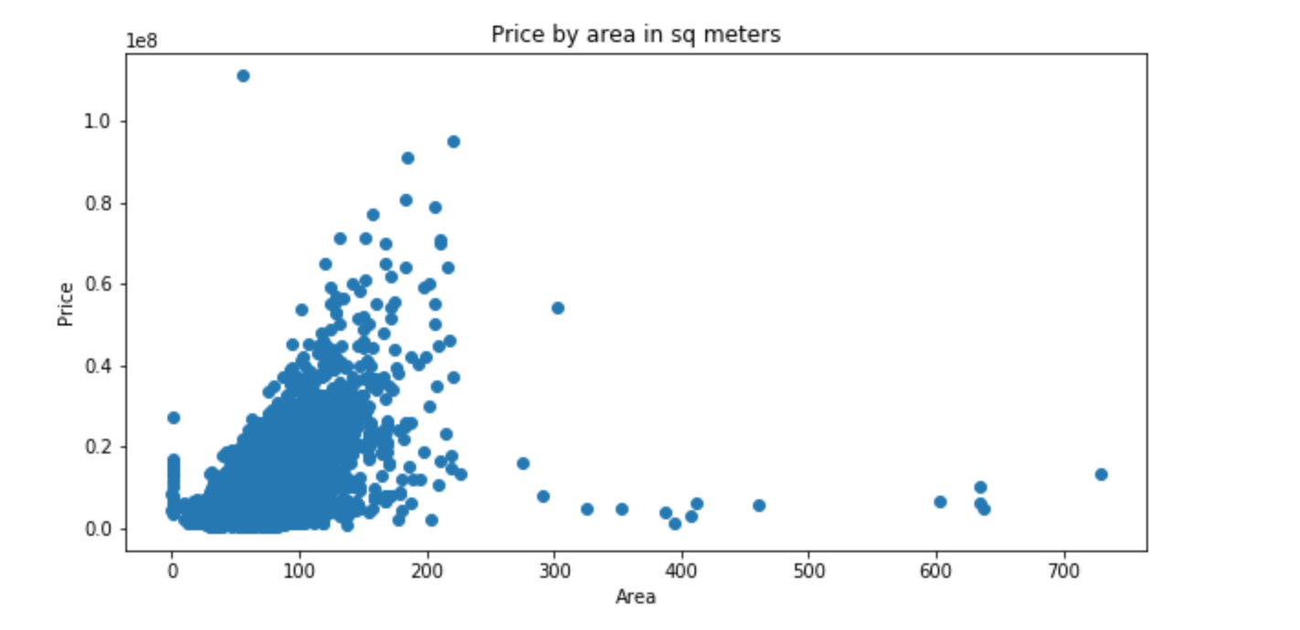
Full_sq, Life_sq, Kitch_sq
Full_sq
Life_sq
Kitch_sq

Slide 22
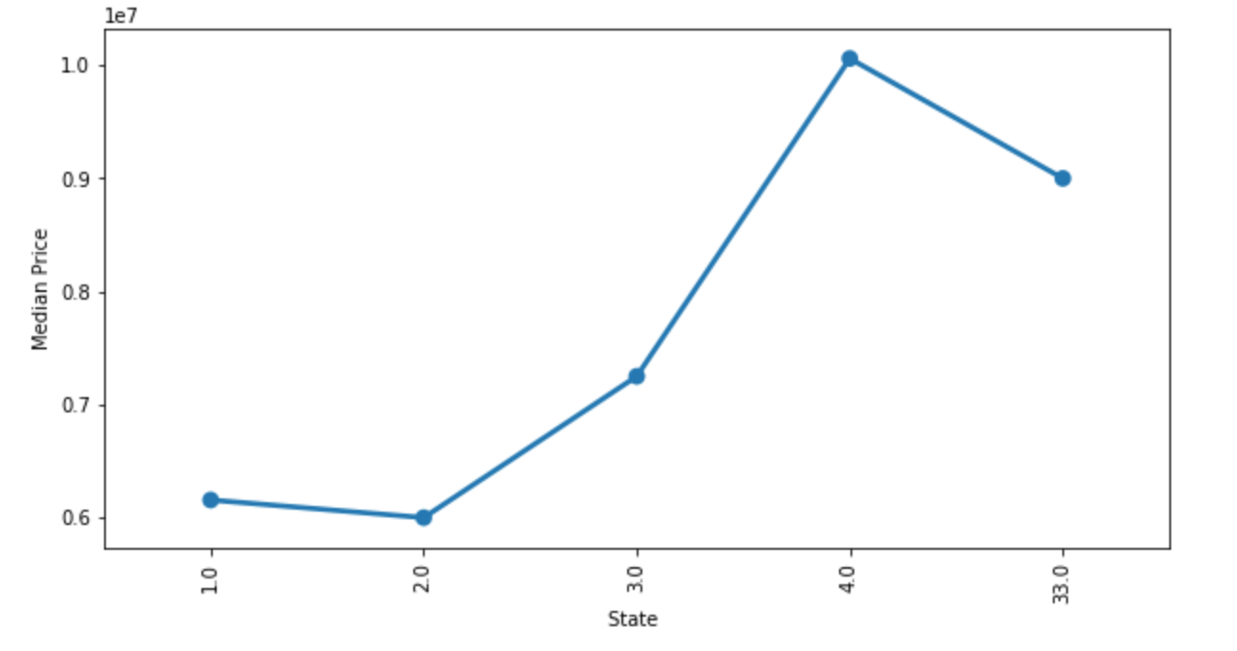
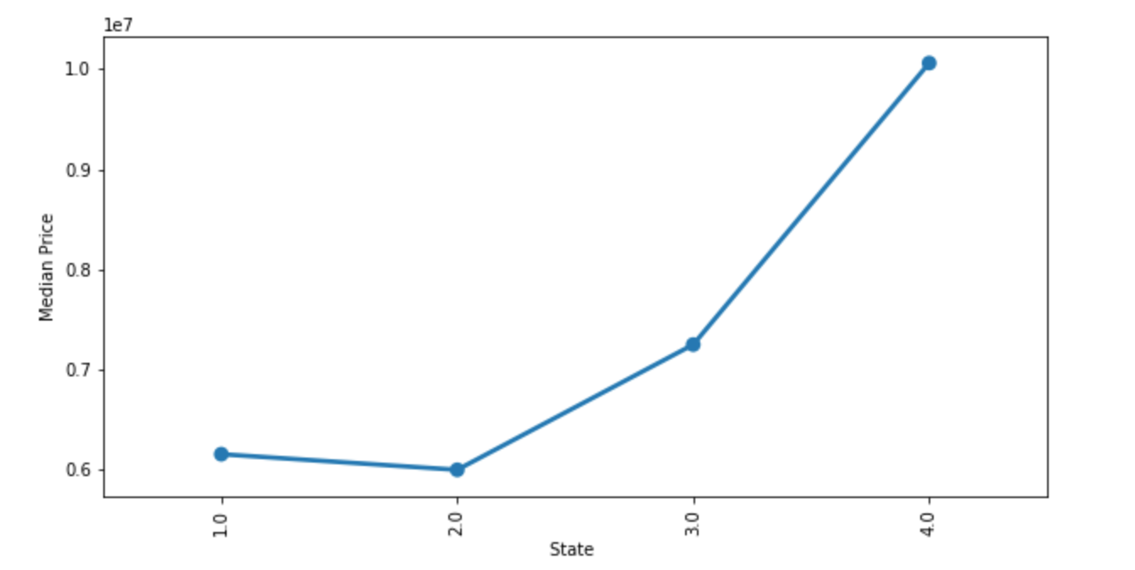
State
Observations: After state 2 there has only been an increase in price for state 3 and state 4

Slide 23
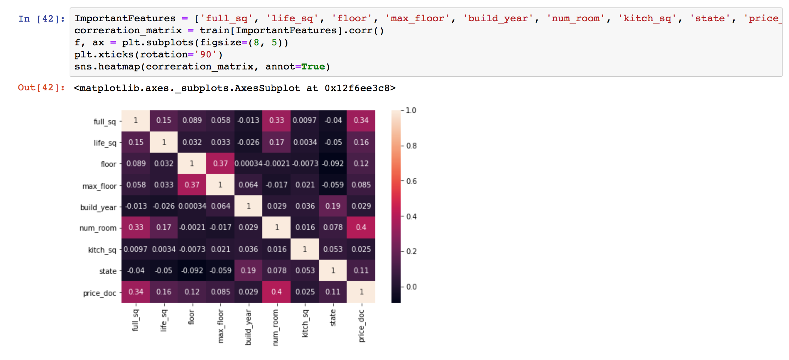
Correlation between these important features:

Slide 24
Model Creation and Model Evaluation
We are going to look at three types of regression models:
Linear Regression
Decision Tree Regressor
Random Forest Regressor

Slide 25
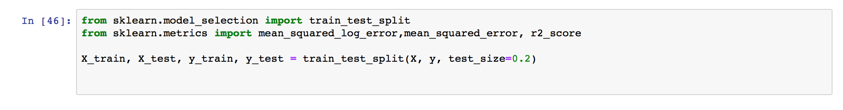
Splitting the data into train and test
We have performed a 80:20 train-test split on the dataset.

Slide 26
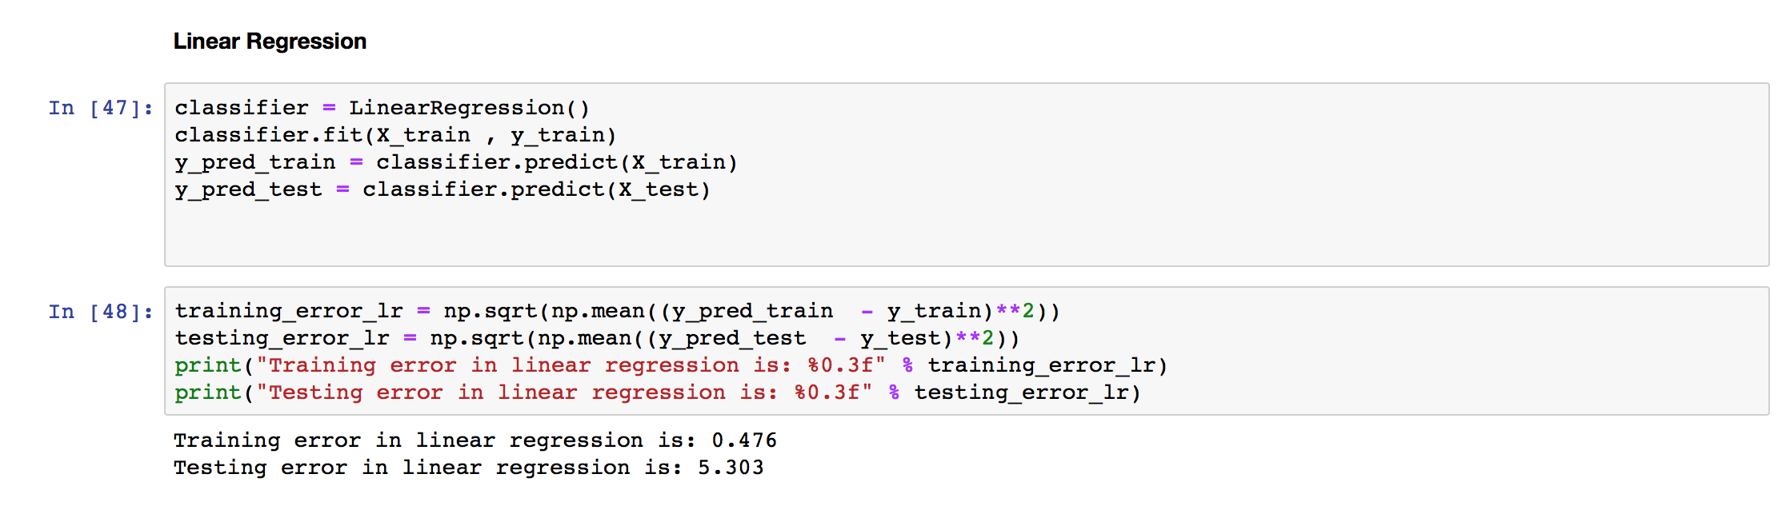
Linear Regression
Training error in linear regression is: 0.467
Testing error in linear regression is: 0.664

Slide 27
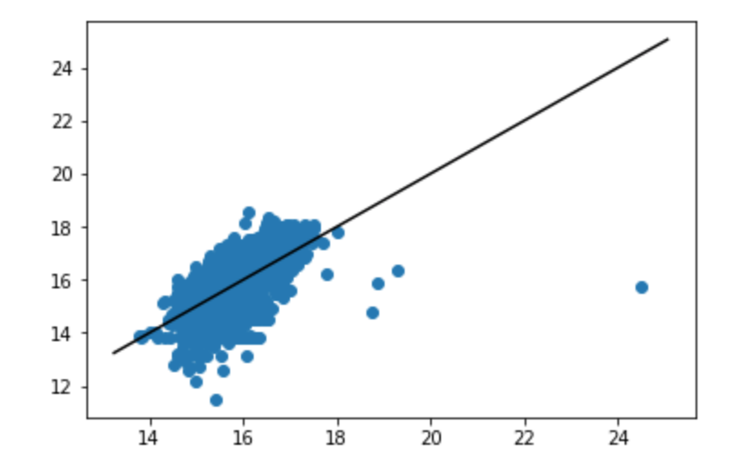
Plotting the Regression Line for :
Linear Regression

Slide 28
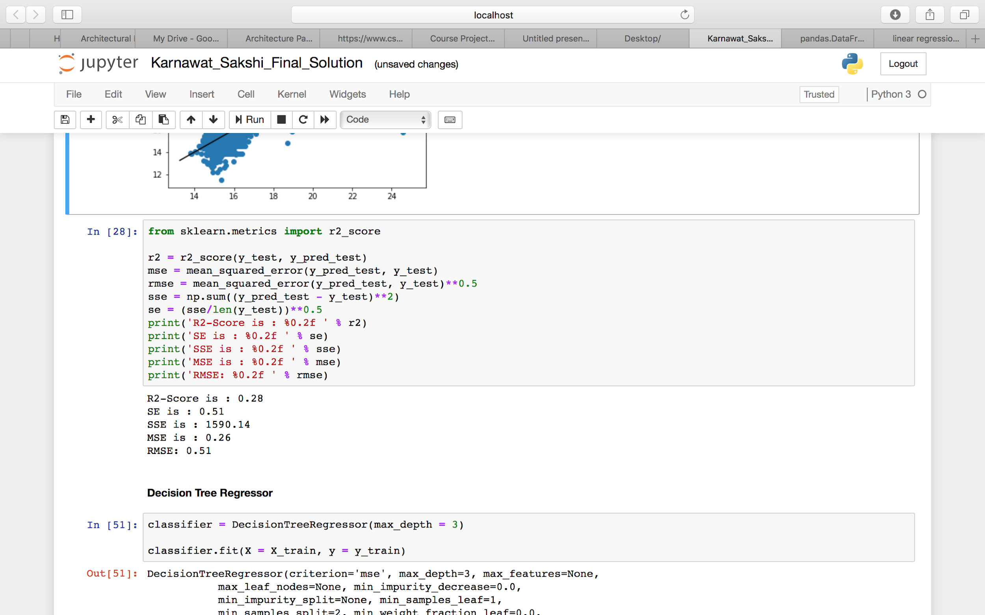
Important Metrics: Linear Regression

Slide 29
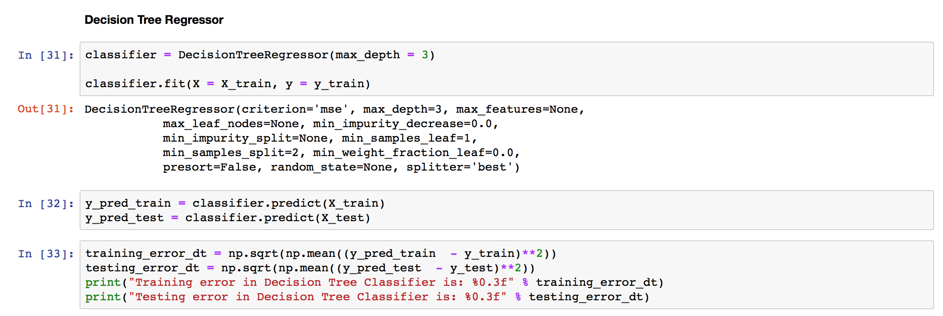
Decision Tree Regressor
Training error in Decision Tree Regressor is: 0.506
Testing error in Decision Tree Regressor is: 0.502

Slide 30
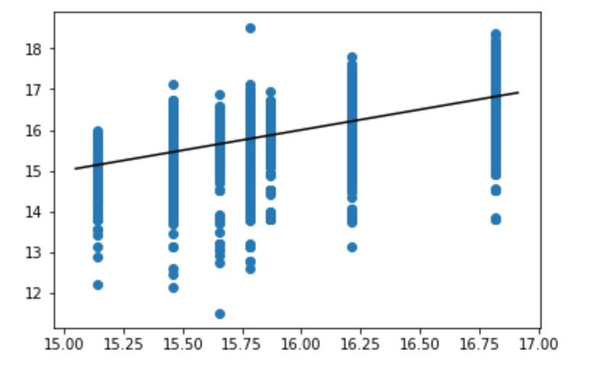
Plotting the Regression Line for :
Decision Tree Regressor

Slide 31
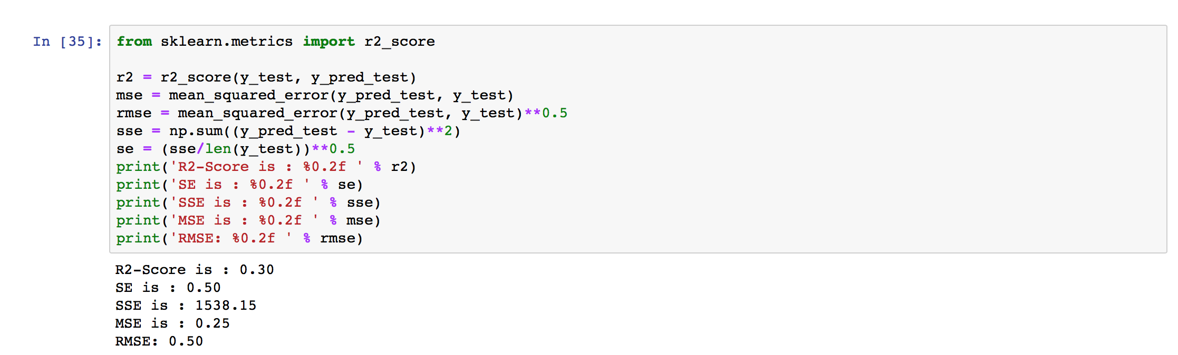
Important Metrics: Decision Tree Regressor

Slide 32
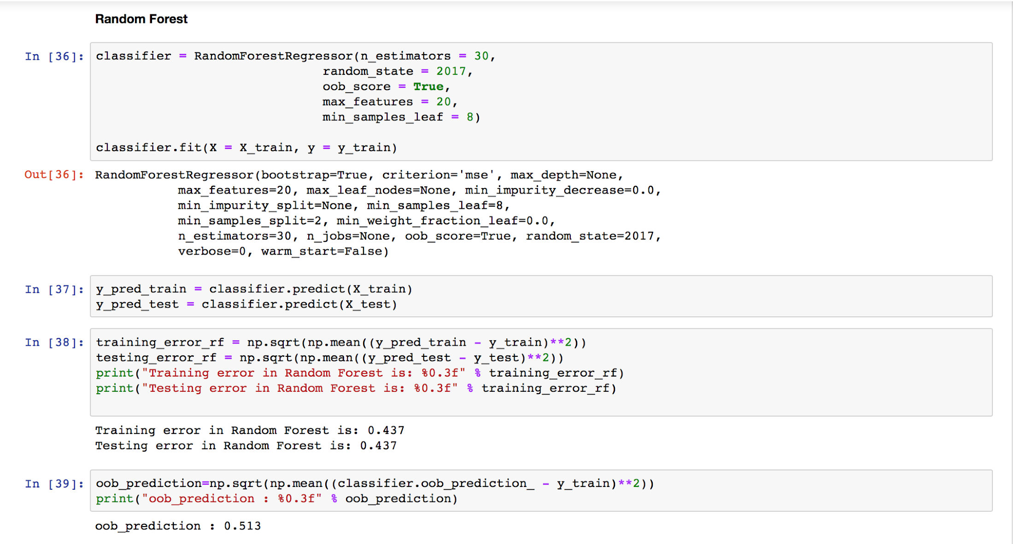
Random Forest Regressor
Training error in Random Forest Regressor is: 0.437
Testing error in Random Forest Regressor is: 0.437

Slide 33
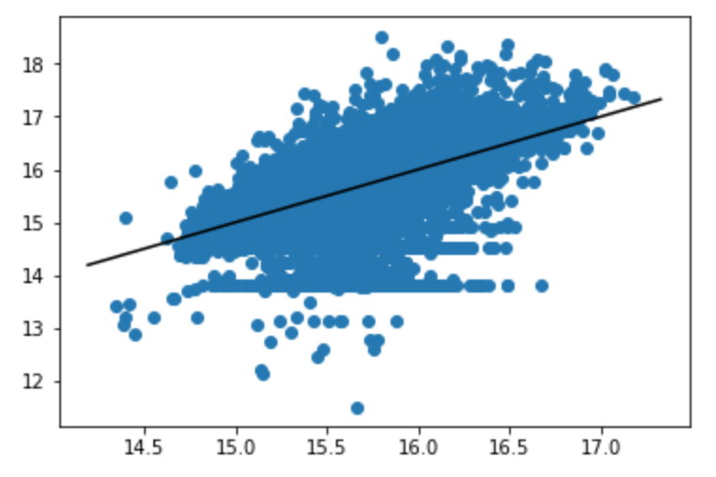
Plotting the Regression Line for :
Random Forest Regressor

Slide 34
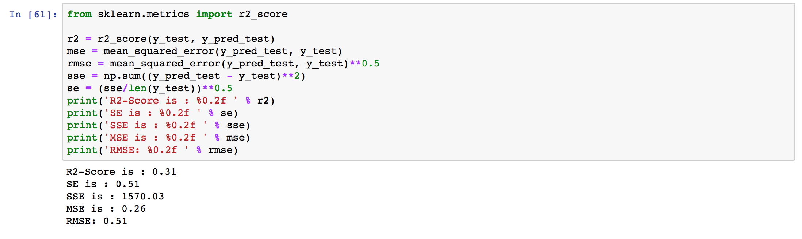
Important Metrics: Random Forest Regressor

Slide 35
Summary
The r2-score keeps getting better from Linear Regression to Decision Tree Regressor to Random Forest Regressor.
This tells us for this dataset Random Forest performed better than the other two models
Also from the regression line plot we can see that data fits slightly better on Random forest than decision tree and linear regression model

Slide 36
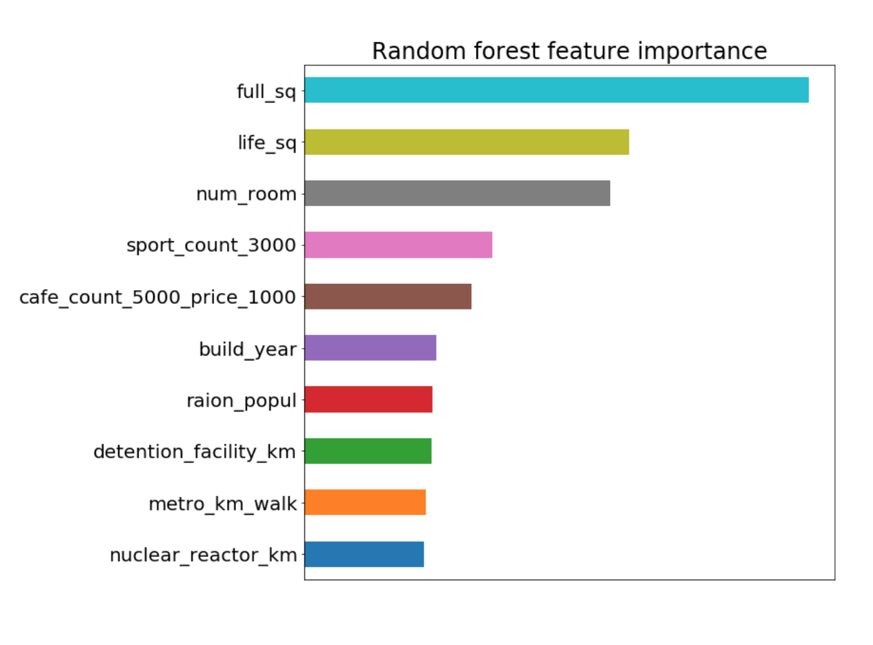
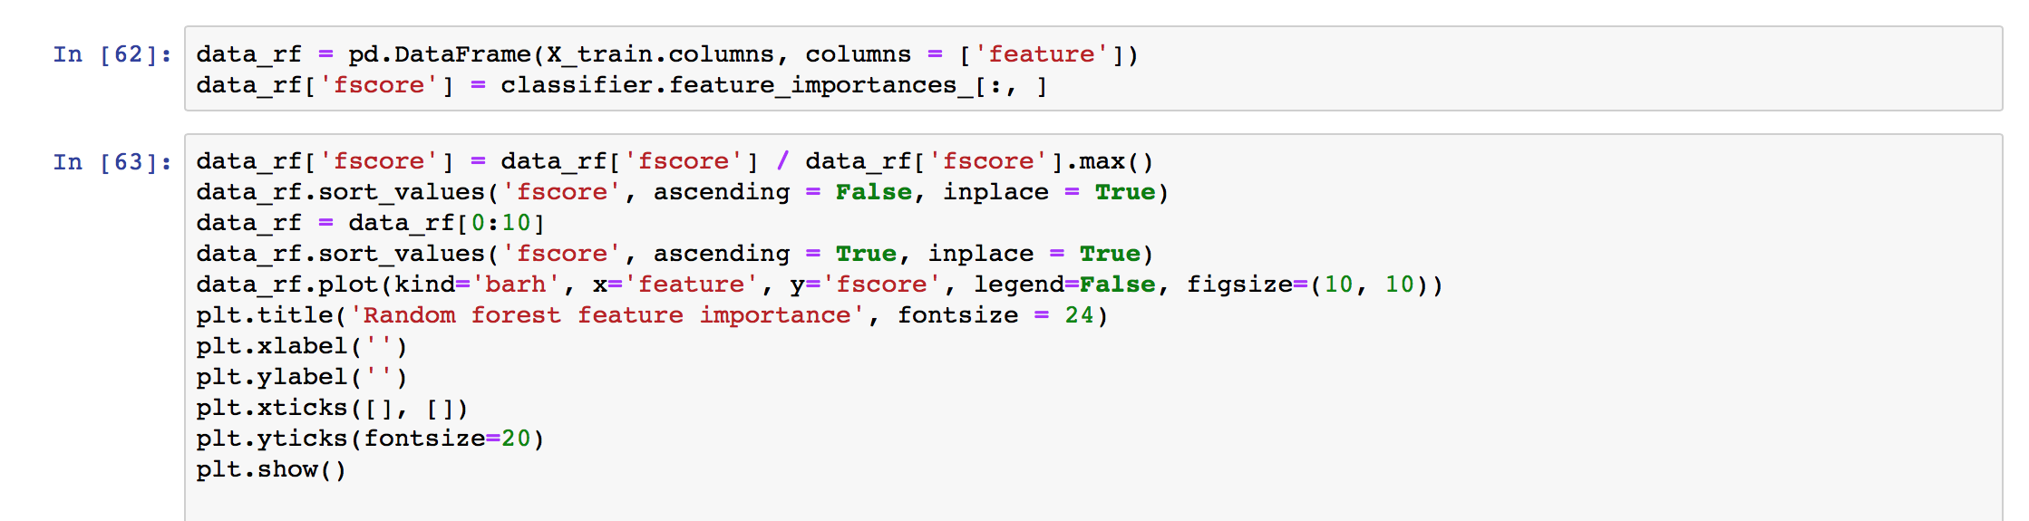
Feature Importance
Observations: Here we can see that full_sq has the highest importance in determining price

Slide 37
Conclusion
I corrected some data quality issues.
I made proper analysis on important features of the data.
I performed feature extraction using timestamp
I can rank the three models as follows:
Random Forest > Decision Tree > Linear Regression
Also important features in determining the prices are:
Full_sq > Life_sq > num_room > build year > max floor > state etc.
We also performed an outlier analysis

Slide 38
References
Introduction to data mining book
https://pandas.pydata.org/pandas-docs/version/0.25/
https://docs.scipy.org/doc/
https://towardsdatascience.com/
https://intellipaat.com/blog/roc-curve-in-machine-learning/
https://www.kaggle.com/c/sberbank-russian-housing-market/
https://scikit-learn.org/

